Slide 1

Lesson: 1.01 Setup
Microsoft Philanthropies TEALS Program
Introduction to computer science

Slide 2
Setup
After this lesson, you will be able to...
Define and identify Python and Jupyter Notebooks
Identify the key concepts that will be covered in the course
Create, save and share a Jupyter Notebook in Google Colab

Slide 3
Today’s plan
Do now
Syllabus
Python and text editor introduction

Slide 4
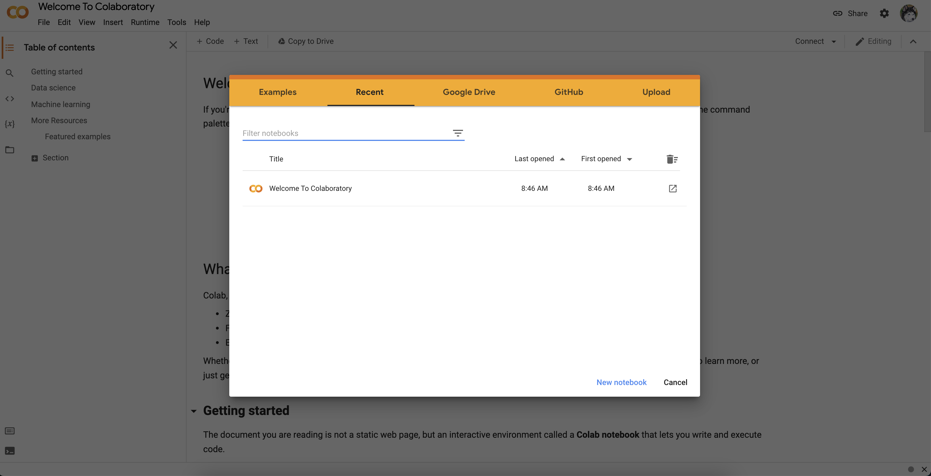
Do now
Go to https://colab.research.google.com/ and choose “New Notebook” at the bottom.
Notes:
Give students 3-4 minutes to follow the instructions on the Do Now page.
Debrief the answers to the questions on the Do Now by calling on students to respond.

Slide 5
Syllabus
Goals for this course
  Create functioning Python programs
  Learn to use basic data types
  Earn to use a text-based language
Present demo of a program written in Python to hook students and to give them an idea of what they will be working with
Notes:
Remind students of creating a block in Snap!

Slide 6
Overview of this course
The major topics covered in this course are as follows:
  Variables
  Conditionals
  Loops
  Functions (user-defined and built-in)
  Lists
  Classes and objects
  Dictionaries
  Music programming
Notes:
Feel free to edit this slide based on the guidance from the curriculum map and the goals for this course.

Slide 7
Lab Projects
Unit 1: MadLibs
Unit 2: Text adventure game
Unit 3: Oregon trail game
Unit 4: Tic-Tac-Toe (2 human players)
Unit 5: Music programming in EarSketch
Unit 6: Guess who? Game
Unit 7: Pokémon
Unit 8: Final project - student created
Notes:
Feel free to edit this slide based on the guidance from the curriculum map and the goals for this course.

Slide 8

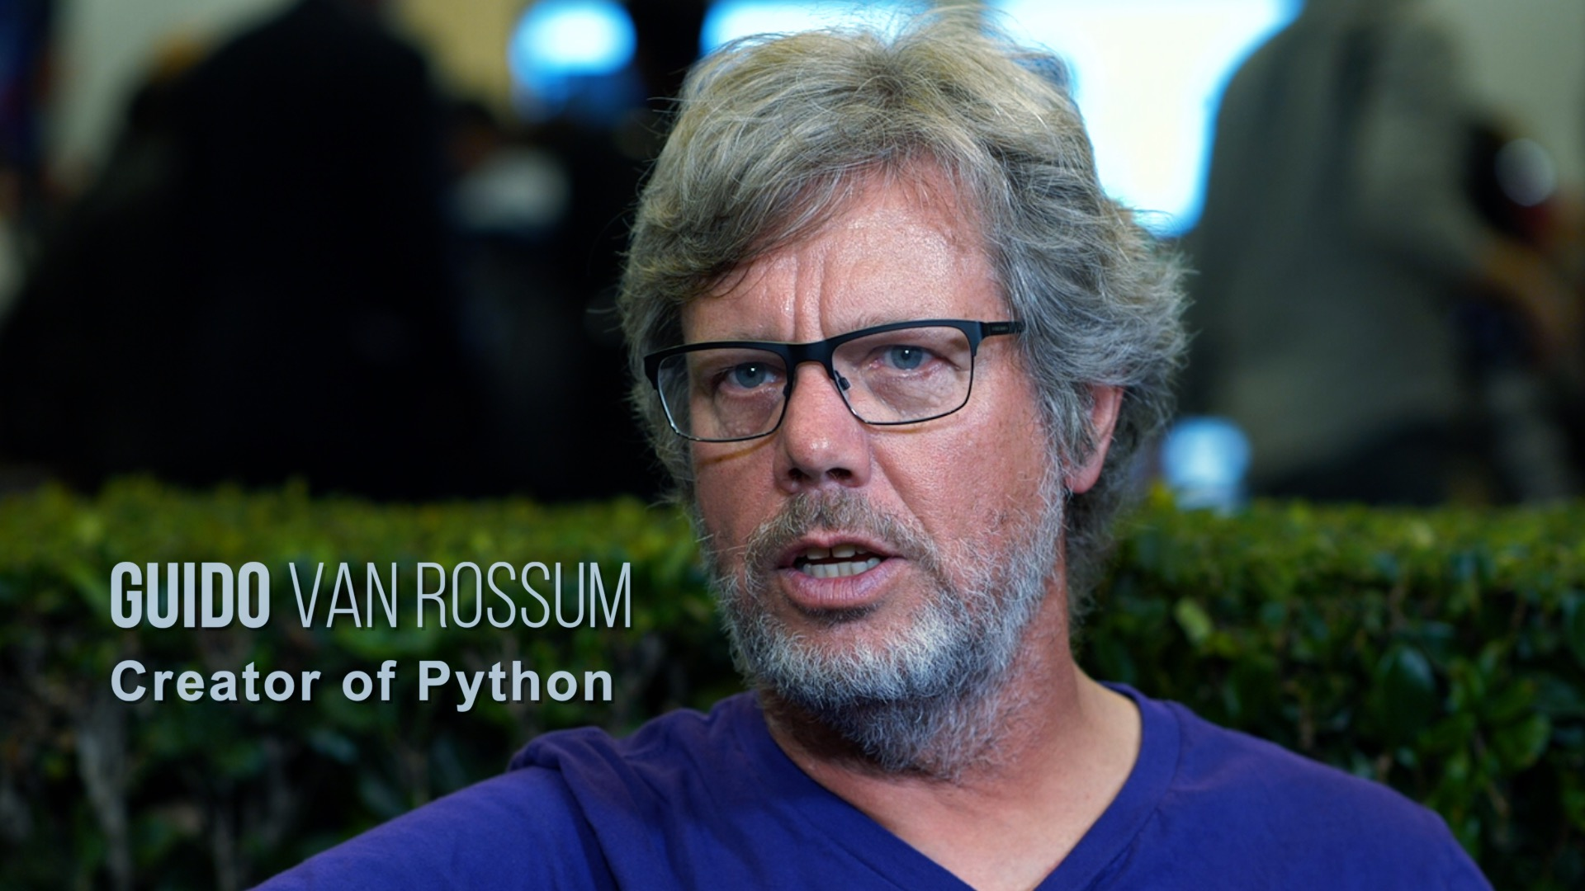

What is Python?
Python is a text-based programming language.
First released 1991. Python3 released 2008.
Widely used in industry and academia.
  100,000,000+ lines of Python at Google, Inc.
Invented by Guido van Rossum in the Netherlands.
Known for its readability.
Named after BBC TV show Monty Python's Flying Circus.

Slide 9
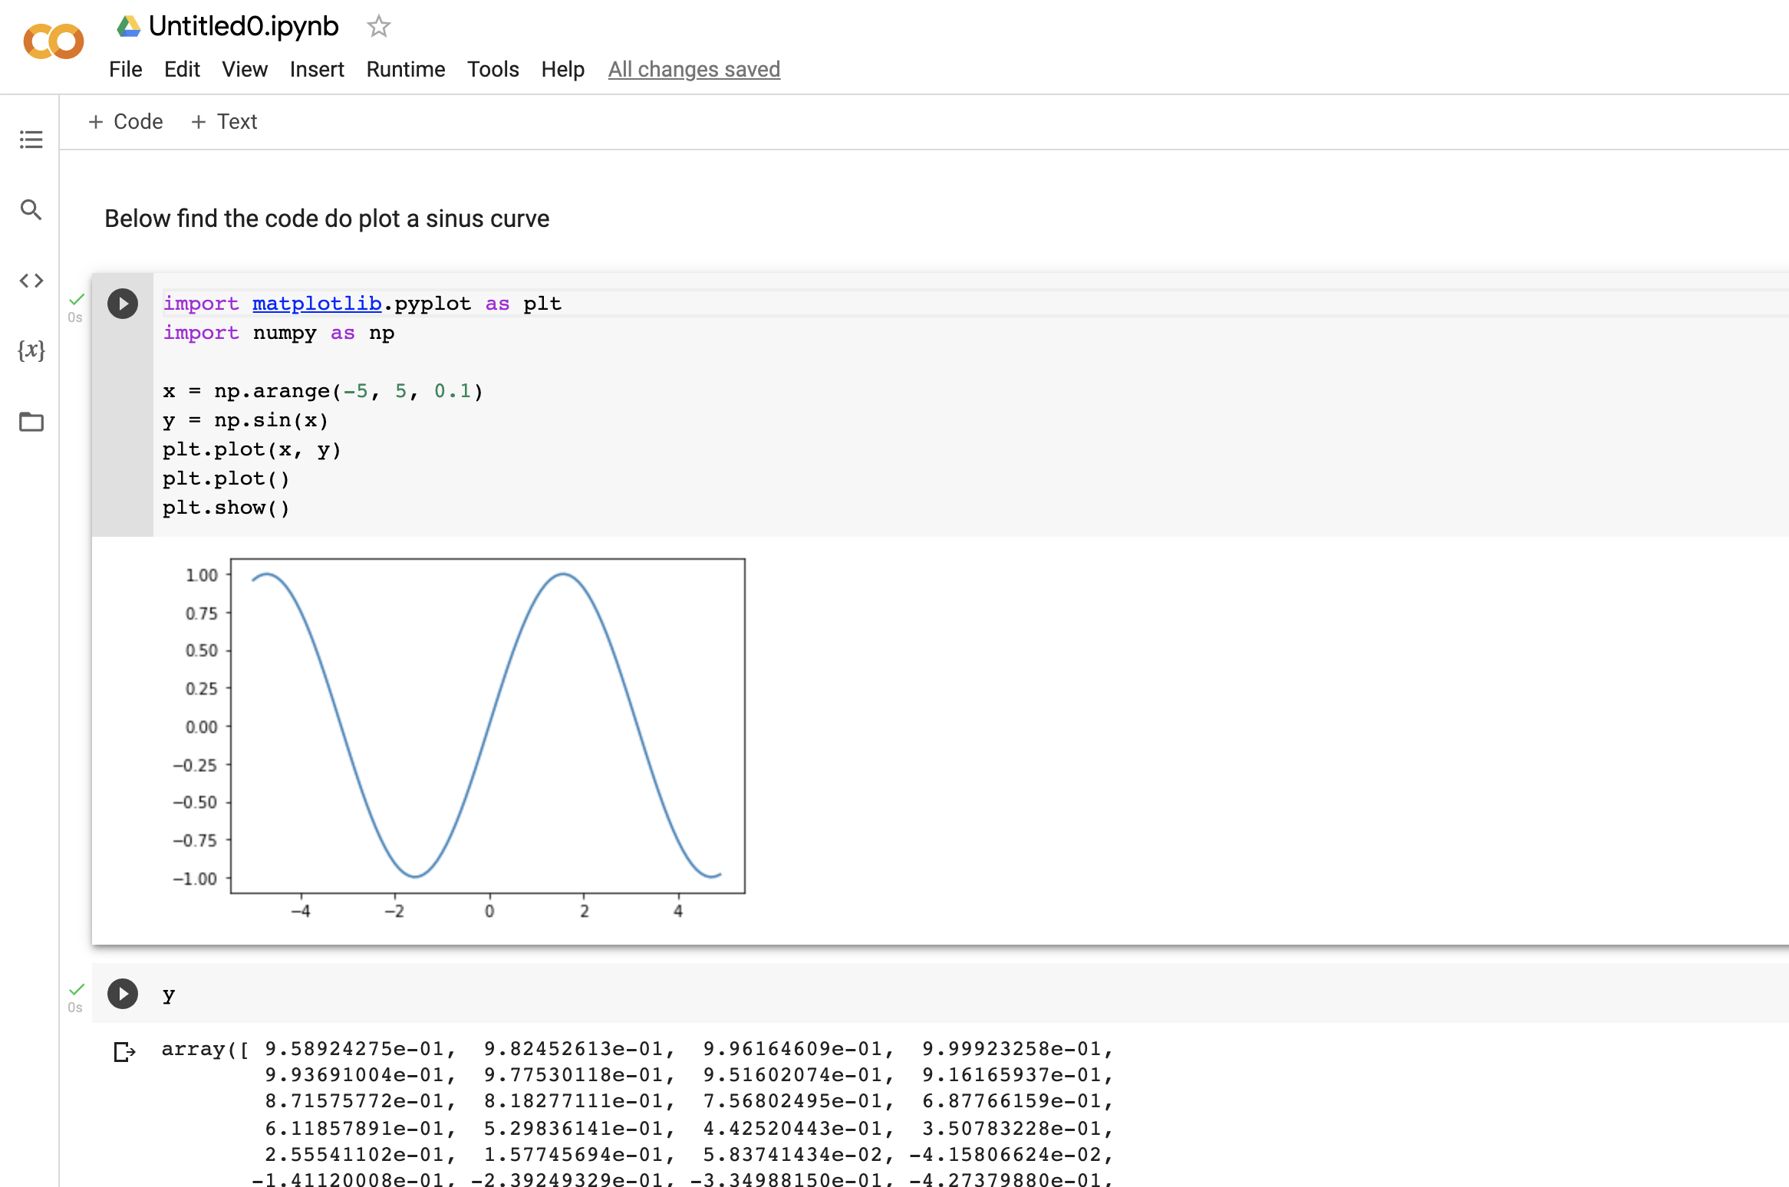
Jupyter Notebooks
The Jupyter Notebook is a web-based programming environment.
It combines live code, equations, narrative text, visualizations, etc.

Slide 10
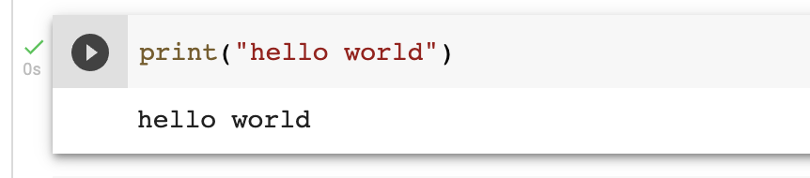
Hello world
Write the following code cell to print “Hello World”
Quotation marks matter
Parentheses matter
Text coloring happens automatically
Use shift-enter or hit the play button to execute

Slide 11
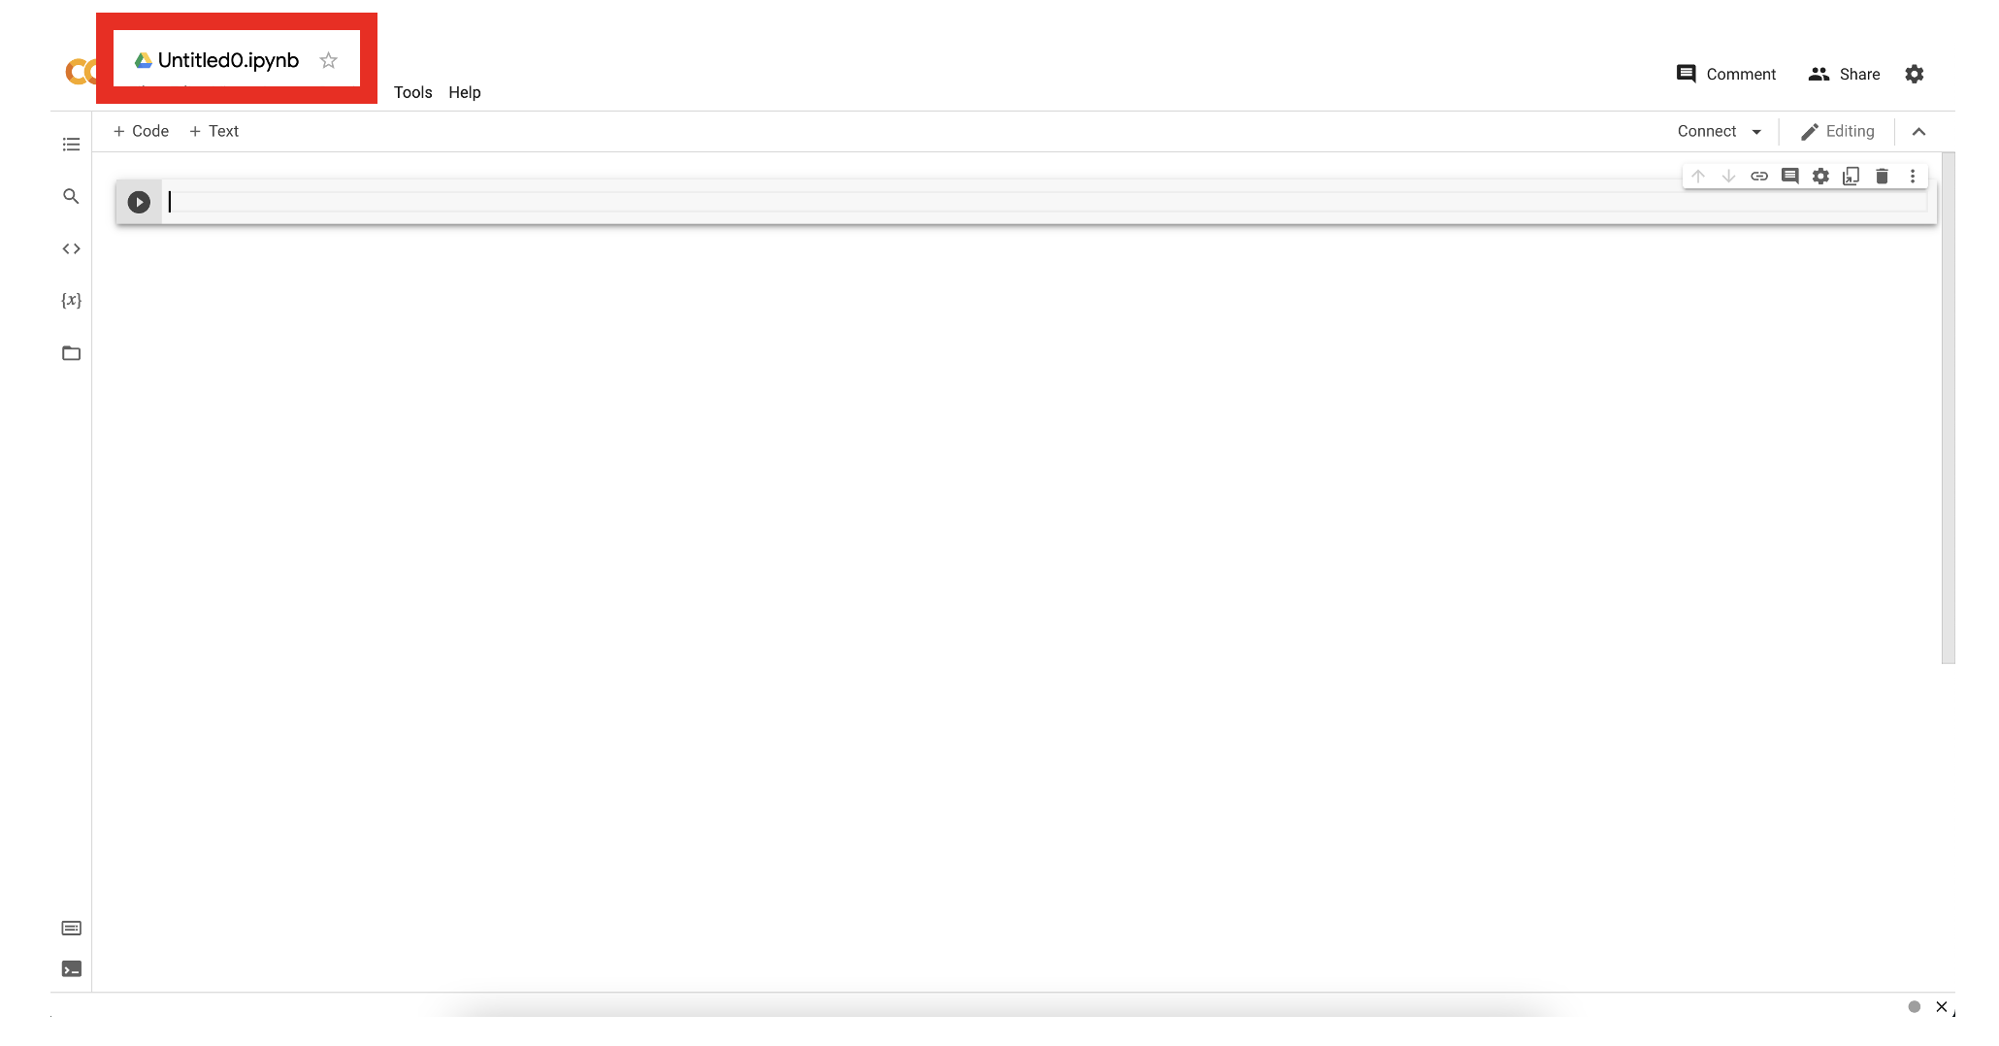
Rename the Jupyter Notebook

Slide 12
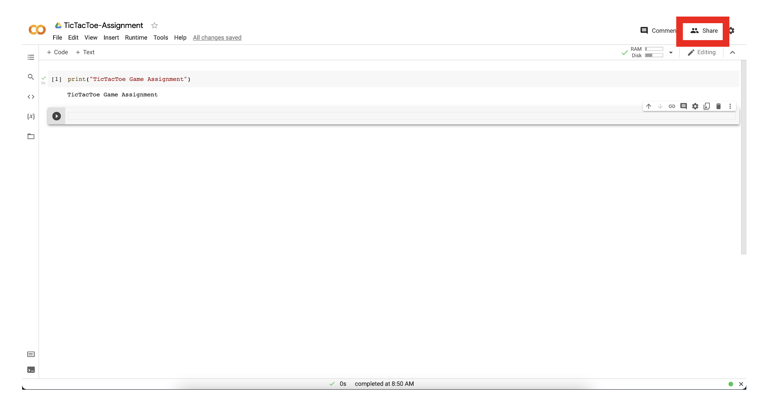
Click Share

Slide 13
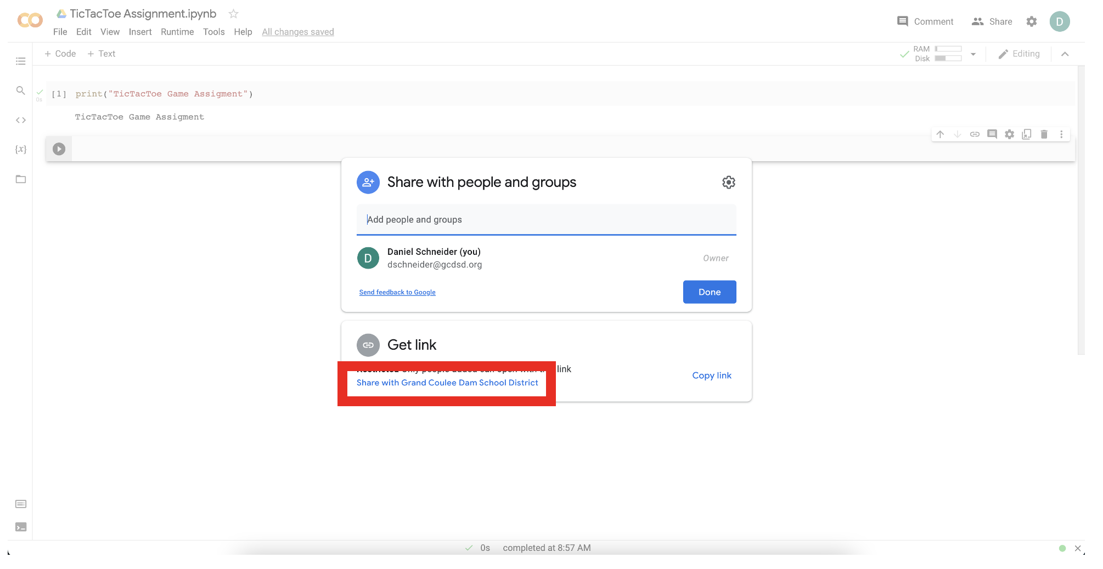
Click Share with Grand Coulee Dam School District

Slide 14
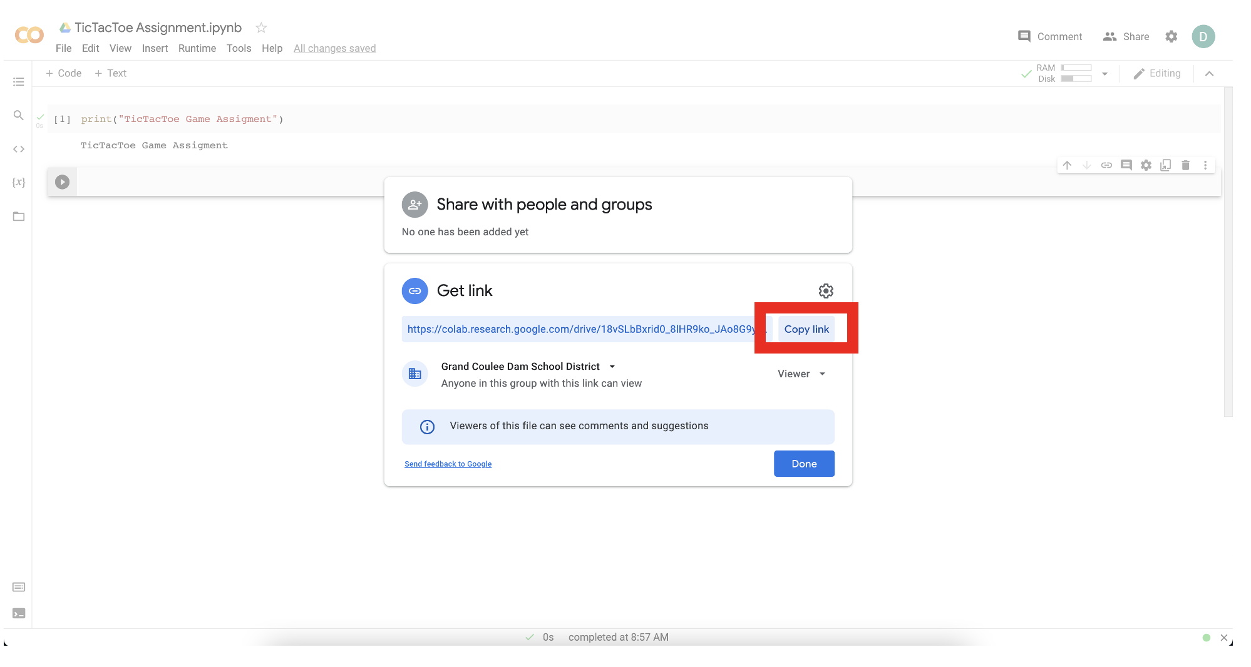
Copy link to share in Google Classroom

Slide 15
Exit ticket
In your notebook, write down two things you learned today.

